Slide 1
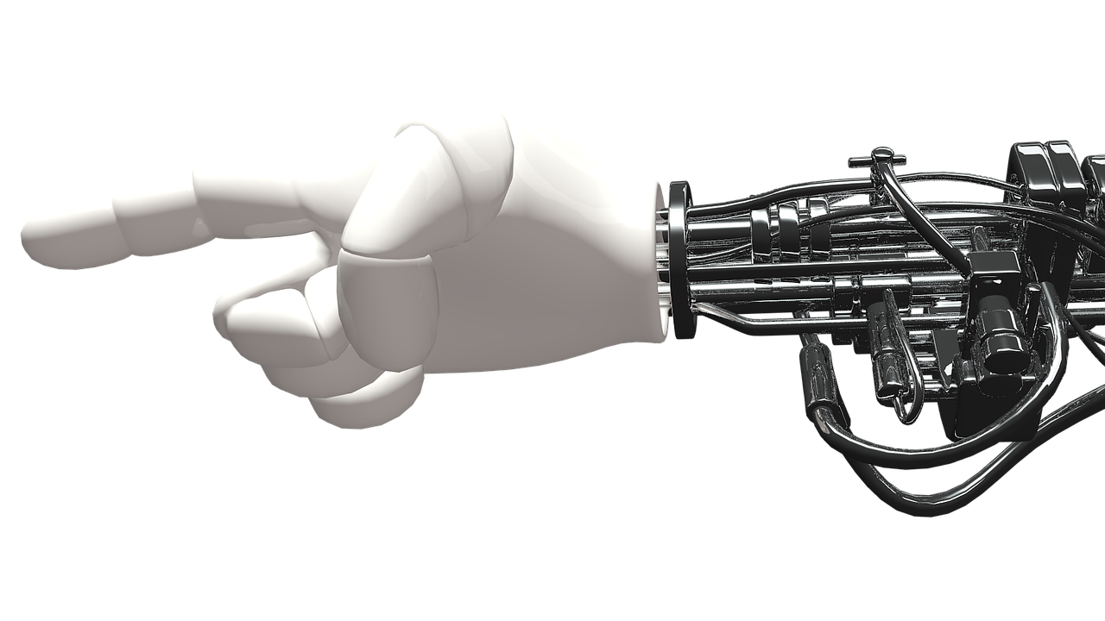
THE HISTORY OF ROBOTICS
How did
it all
begin?
By Roxy Bitner

Slide 2
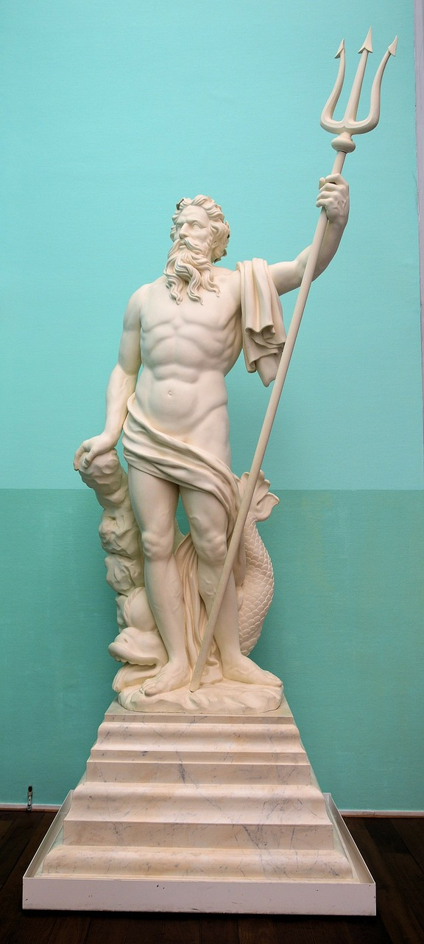
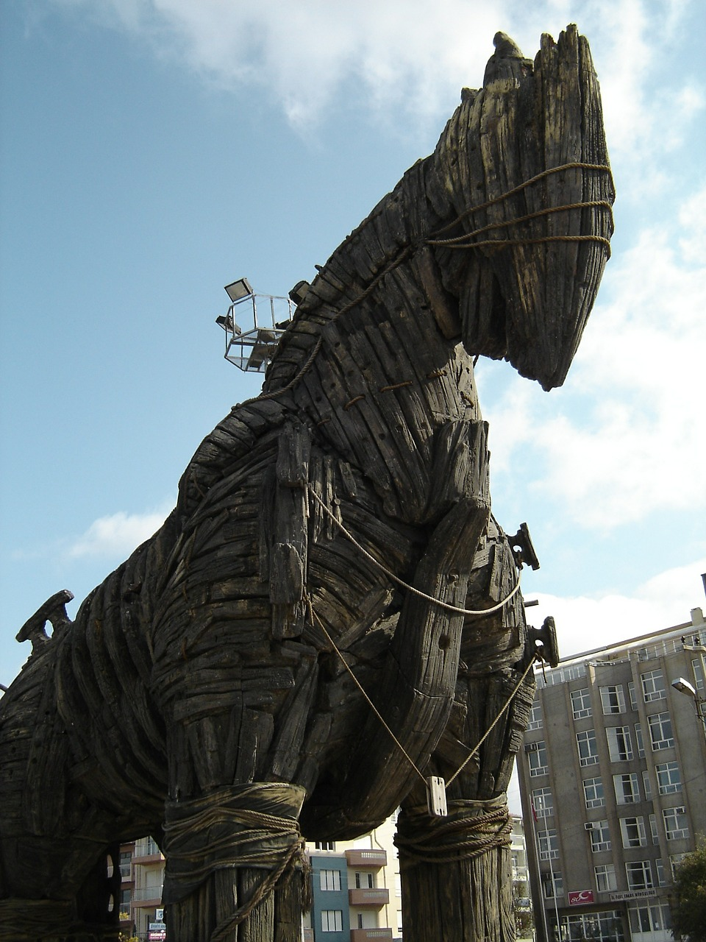
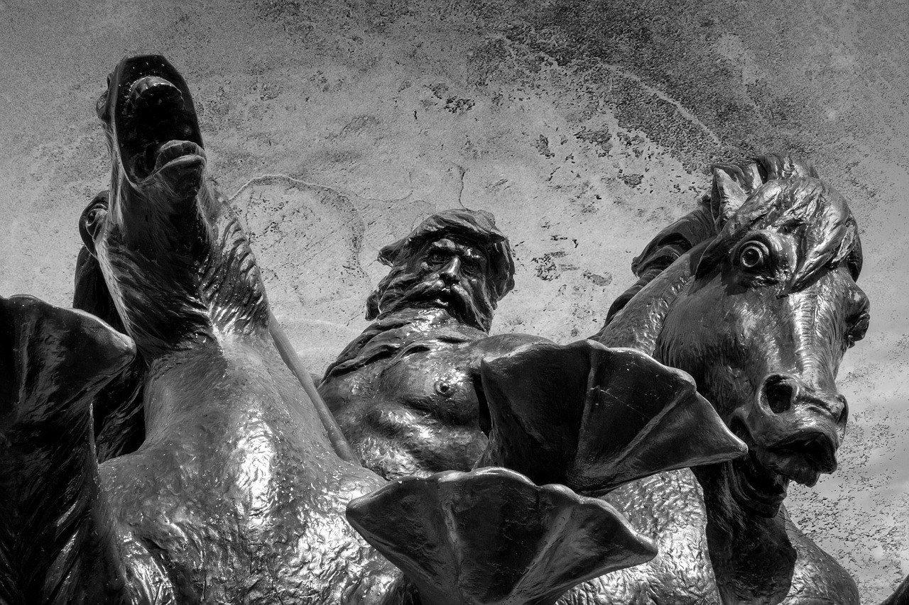
320 B.C.
Many ancient mythologies included artificial people: Greek, Jewish, Indian, and Dutch to name a few.

Slide 3
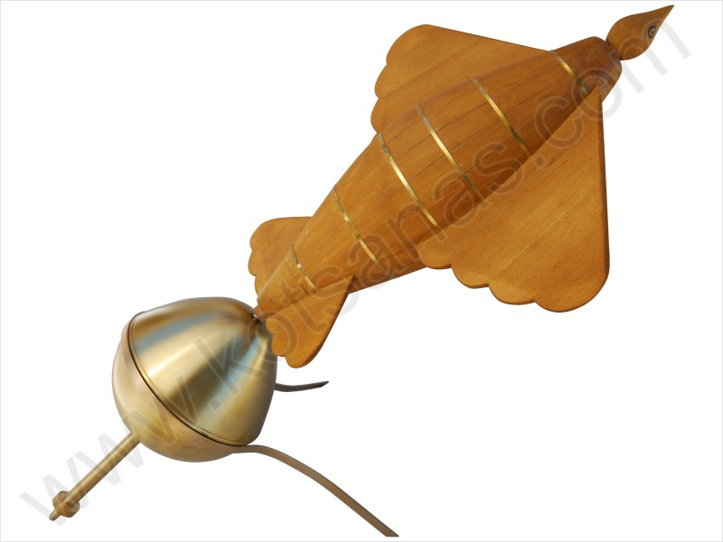
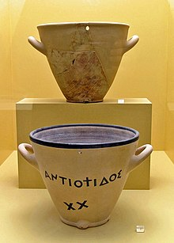
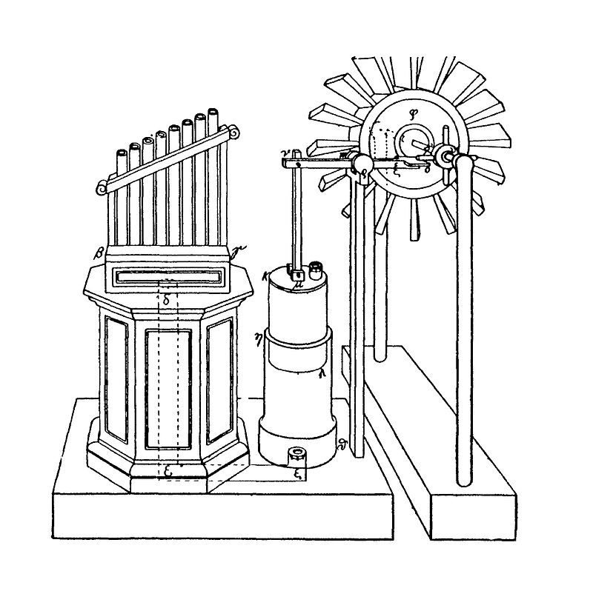
In the 4th century BC, the Greek mathematician, Archvtas of Tarentum postulated a mechanical bird he called “The Pigeon” and it was propelled by steam
The clepsydra was another automation made in 250 BC by Ctesibius of Alexandria, a physicist and inventor from Egypt
Hero of Alexandria (10-70 AD) apparently made many inventions that were automated, including one the could speak

Slide 4
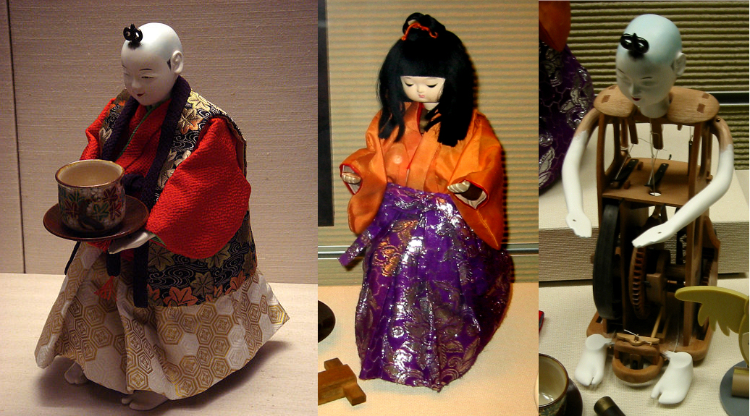
TEA SERVING TOY
These “toys” are called Karakuri ningyo. They are automata made in Japan between 1800-1900. Karakuri means mechanisms or trick, and ningyo refers to a person. The toys were intended to be entertaining. They could gesture and conduct a number of different actions, including tea serving.

Slide 5
1495
Leonard da Vinci sketched plans for a humanoid robot. It has since been made into a model in respect for his ingenuity.

Slide 6
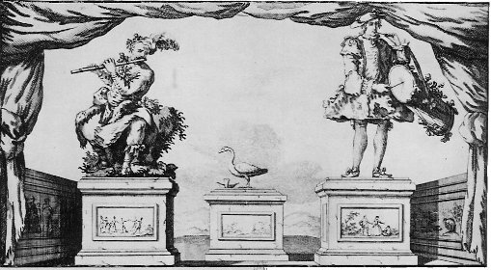
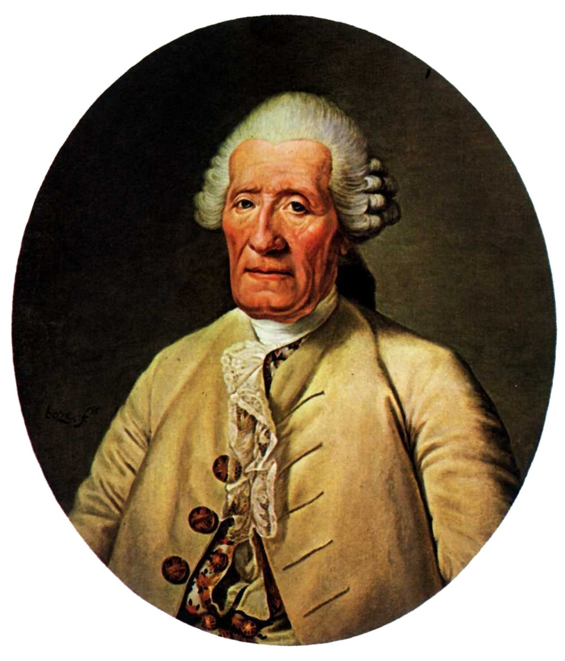
1700 - 1900
Life-sized animations were made. In 1739, Jacques de Vaucanson created a mechanical duck that could crane its neck, flap its wings, and swallow food. It could eat kernels of grain, metabolize, and defecate them. It was actually a trick since the inventor stored the material to be defecated in a compartment inside the duck. He made several other mechanical models as well.

Slide 7
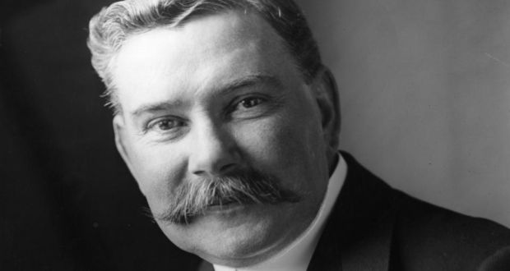
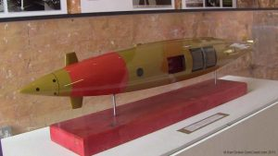
1877
The Brennan torpedo was patented by Louis Brennan, an Irish-born Australian inventor. It had two contra-rotating propellers that were propellers spun rapidly. It could be guided to its target up to 1800 metres away. It was one of the earliest guided missiles.

Slide 8
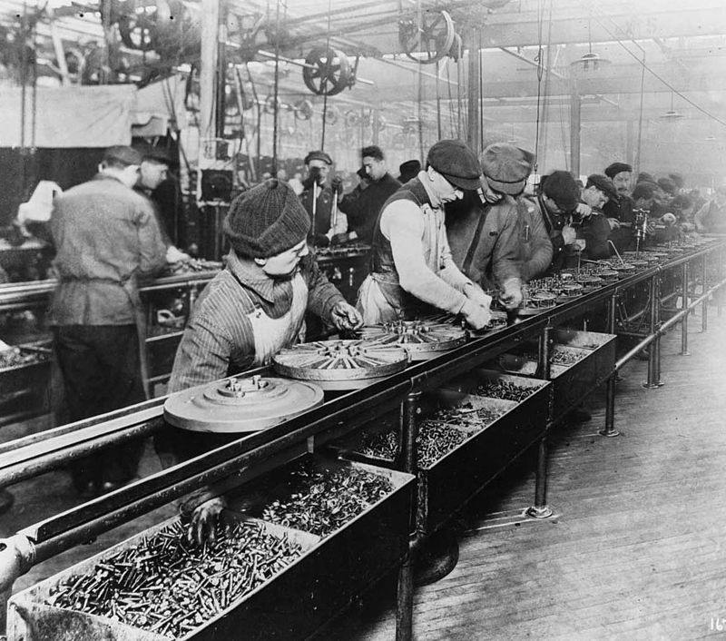
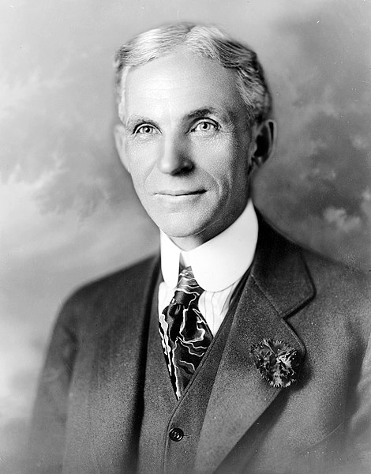
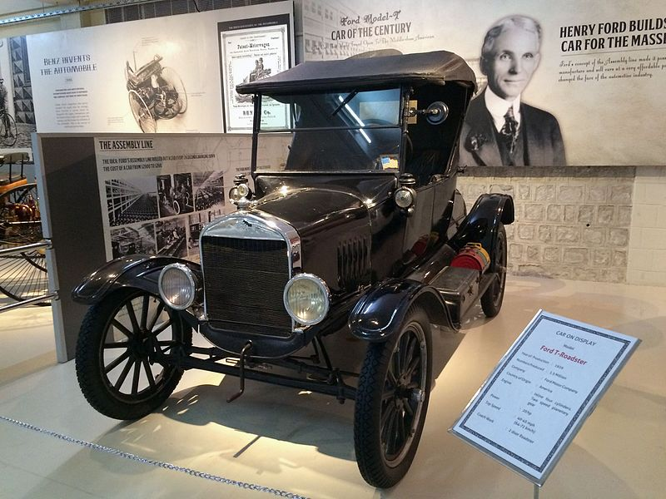
1913
Henry Ford installed the world’s first moving conveyor belt-based assembly line for his car factory. This made it possible to assemble a Model T in only 93 minutes.

Slide 9
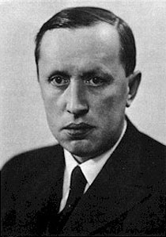
1921
The world “robot” was used by the Czech play write Karel Capek in a play about robots that turn on their human makers and take over the world. The word comes from the root robota which means servitude or forced labour. When the play was translated into English, the term “robot” was accepted into the English language.

Slide 10
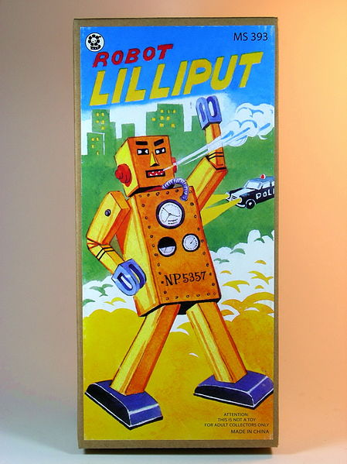
1932
A wind-up walking toy, called Lilliput, was created in Japan. It stood 15 com tall and was made from tinplate.
See video of remake

Slide 11
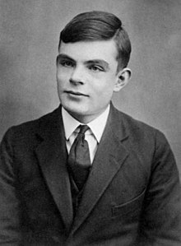
1937
Alan Turing releases a paper called “On Computable Numbers” and it begins the computer revolution.

Slide 12
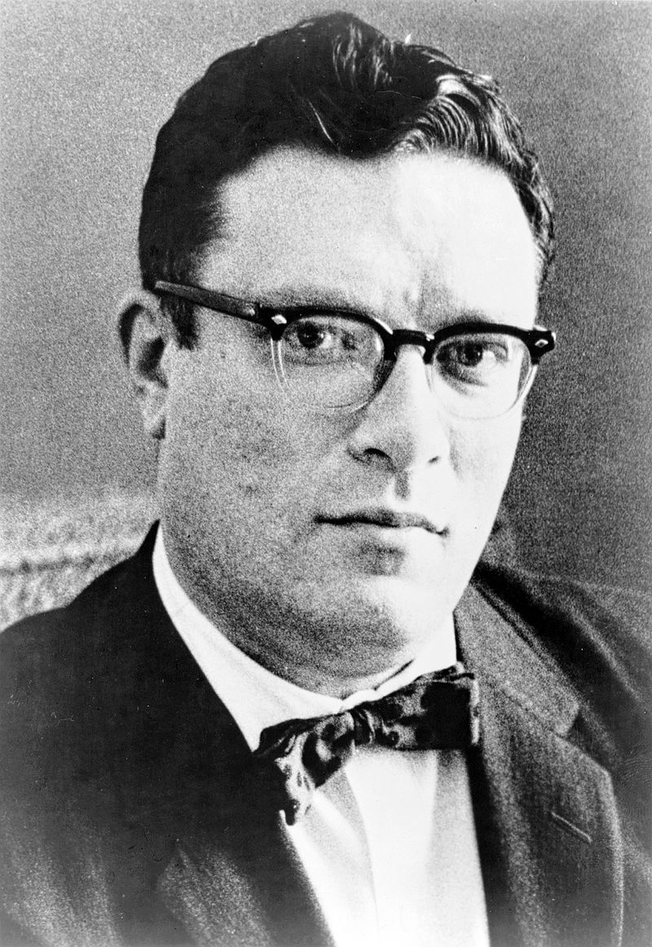
1941
Science fiction writer Isaac Asimov composes a short story called “Liar” in which he refers to the three laws of robotics:
A robot may not injure a human being or, through inaction, allow a human being to come to harm.
A robot must obey any orders given to it by human beings, except where such orders would conflict with the First Law.
A robot must protect its own existence as long as such protection does not conflict with the First or Second Law.

Slide 13
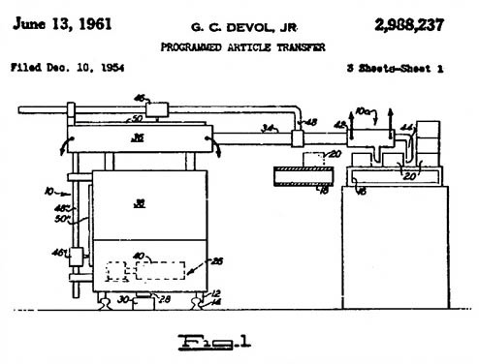
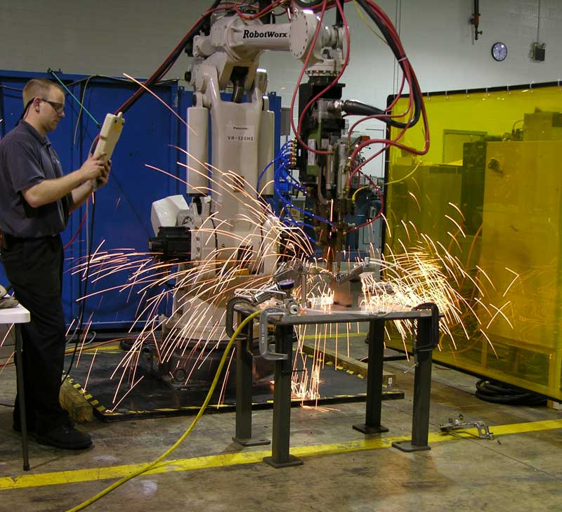
1954
George Devol and Joe Engleberger design the first programmable robot ‘arm’. This later become the first industrial robot, completing dangerous and repetitive tasks on an assembly line at General Motors (1962).

Slide 14
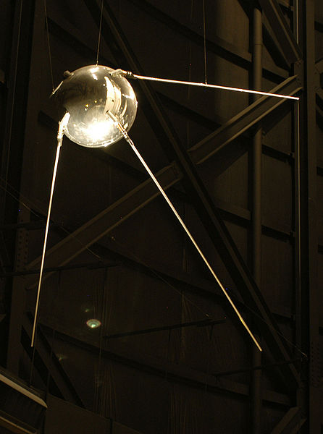
1957
Sputnik I was launched by the Soviet Union (Russia) as the first artificial Earth satellite. It went into an elliptical low Earth orbit on October 4, 1957. It was a 58 cm diameter polished metal sphere with four external antennas to broadcast radio pulses. This event triggered the Space Race between the Soviet Union and the USA to get a man on the moon.

Slide 15
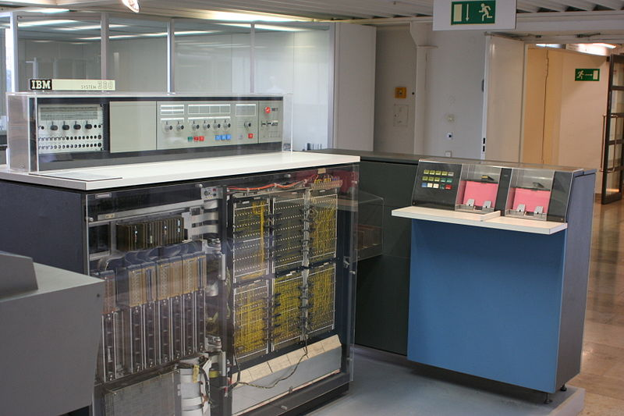
1964
IBM 360 becomes the first computer to be mass produced.
A slightly upgraded version

Slide 16
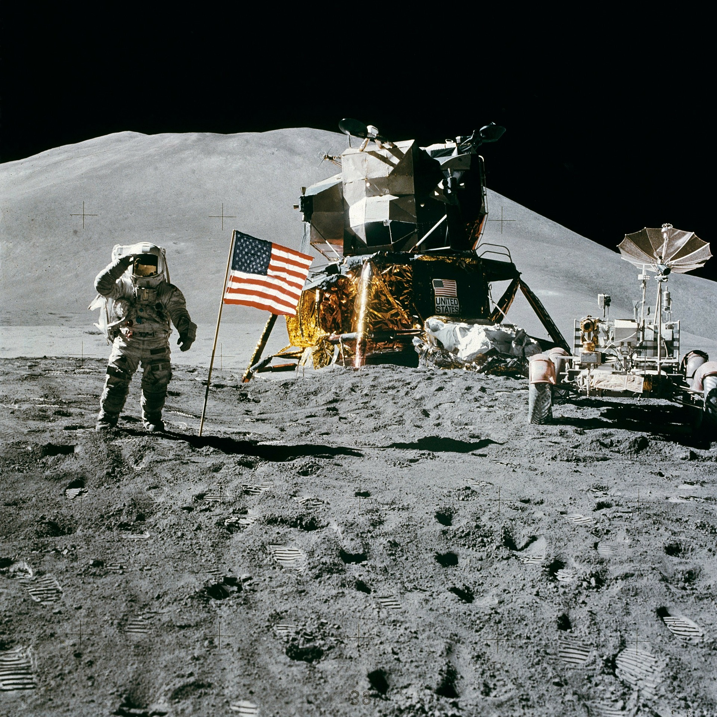
1969
The USA lands astronauts on the moon.

Slide 17
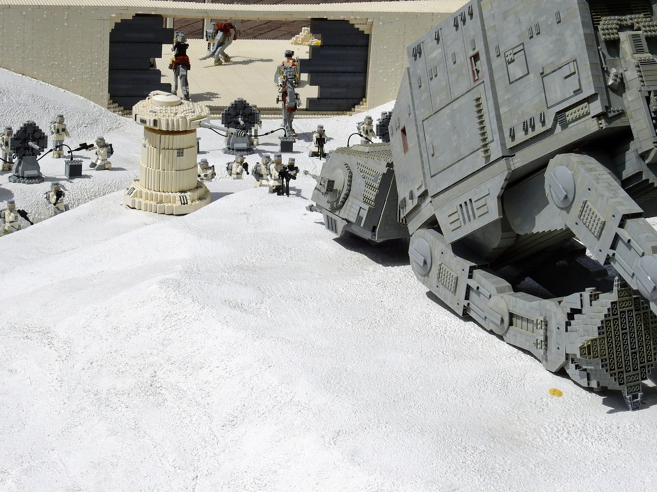
1998
LEGO launches its first Robotics Inventions System

Slide 18
1999
Sony releases the first version of AIBO, a robotic dog.
https://www.youtube.com/watch?v=fV7fTkGUIWI

Slide 19
2000 - 2015
Check out this wonderful online timeline to see more recent robotic advancements.
https://www.timetoast.com/timelines/653380

Slide 20
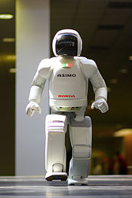
2000
ASIMO (Advanced Step in Innovative Mobility) is a humanoid robot created by Honda. They began its development in the 1980’s, and their original intent was to make a walking robot.
ASIMO is 130 cm tall and 54 kg (119 lbs). It is meant to be a mobility assistance robot for people living with challenges to their mobility. It can recognize moving objects, postures, gestures, sounds and faces. This allows it to interact with humans.
Touching the picture to the right will connect you to a video of the robot in action.
https://www.youtube.com/watch?v=RRVZjdk5OsQ

Slide 21
Types of robotics
Visit this fantastic website to learn about the many type of robots available now.
http://www.allonrobots.com/types-of-robots.html

Slide 22
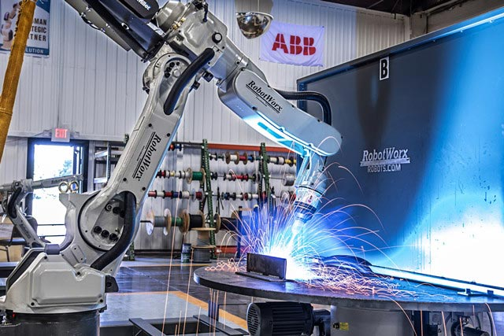
applications
With a partner, search the sites provided below to learn about the various applications for robots in different fields.
https://www.robots.com/applications
https://www.universal-robots.com/applications/
http://robotik.dfki-bremen.de/en/research/fields-of-application.html
http://www.military.com/video/logistics-and-supplies/military-equipment/bigdog-coming-to-a-corps-near-you/2732968433001
https://www.youtube.com/watch?v=fH4VwTgfyrQ
http://triotree.com/blog/nanorobots-introduction-and-its-medical-applications/
http://engineering.nyu.edu/mechatronics/smart/pdf/Intro2Robotics.pdf

